Slide 1
Design Tactics

Slide 2
First, let’s take a step back
Quality Attribute: A measurable or testable property of a system that is used to indicate how well the system satisfies the needs of its stakeholders.
Architecturally Significant Requirement (ASR): A requirement that will have a profound effect on the architecture – that is the architecture may be significantly different in the absence of this requirement.
ASRs, often, but not always, take the form of quality attributes requirements – the performance, security, modifiability, availability, usability, that the architect must provide the system.

Slide 3
Quality Attributes – Master List
Operational categories
  Availability
  Interoperability
  Reliability
  Usability
  Performance
  Deployability
  Scalability
  Monitorability
  Mobility
  Compatibility
  Security
  Safety
Developmental categories
  Modifiability
  Variability
  Supportability
  Testability
  Maintainability
  Portability
  Localizability
  Development distributability
  Buildability

Slide 4
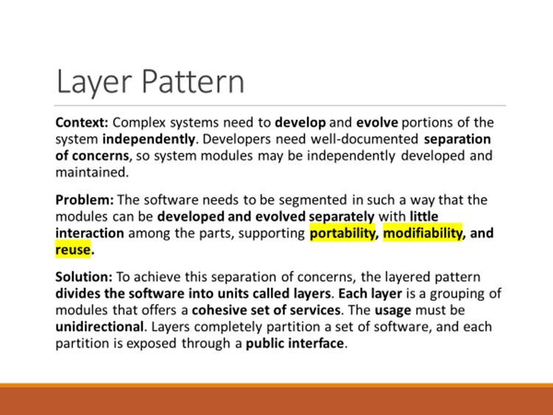
Patterns and Quality Attributes
Patterns: Packaged strategies for solving some of the problems facing a system
A pattern typically packages multiple design decisions into a single package. In other words, a packages generally address multiple Quality Attributes and ASRs.

Slide 5
Relationships Between Tactics and Patterns
A pattern is a high level structural design choice
A tactic is a lower level design decision to achieve a QA response
Patterns are built from tactics; if a pattern is a crystal, a tactic is a molecule or an atom.
For example the layered pattern utilizes the tactics:
  Increase semantic coherence
  Encapsulation
  Abstract common services
  Restrict communication paths
  Use an intermediary
All of which are methods of achieving the Quality Attribute Modifiability

Slide 6
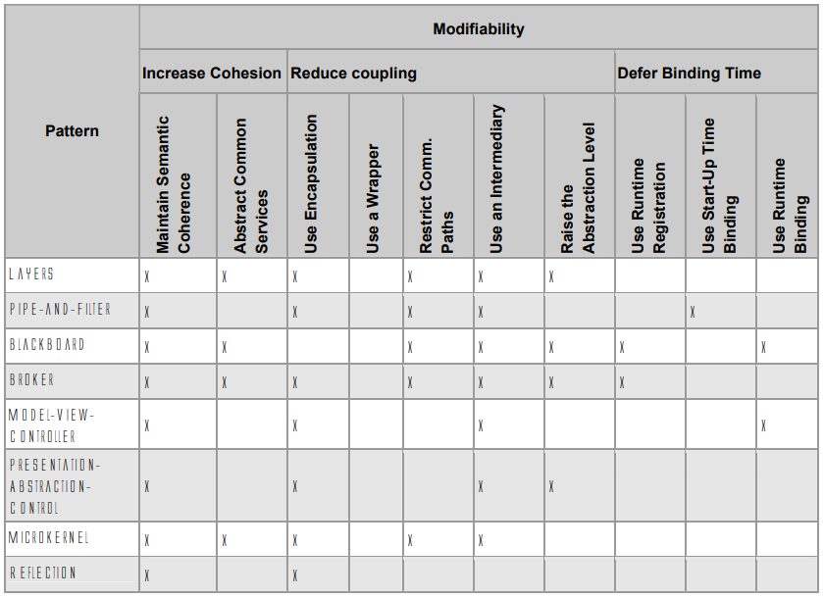
Modifiability Tactics and Patterns
SEI Technical Report: Modifiability Tactics

Slide 7
Tactics Augment Patterns
Patterns solve a specific problem but are neutral or have weaknesses with respect to other qualities.
E.g., the broker pattern may have:
Performance bottlenecks
Single point of failure - availability
Testability complexity in multi-process/processor systems
No implicit support for security
Consider possible availability tactics

Slide 8
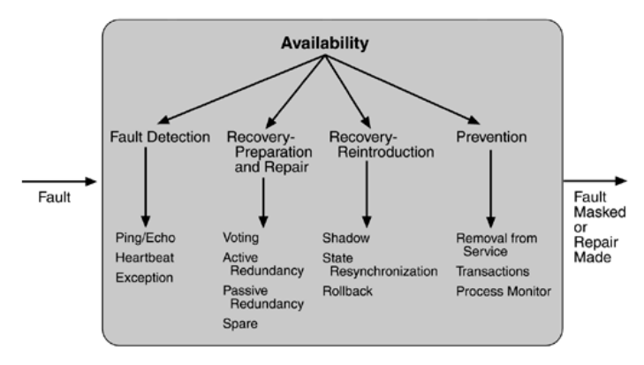
Example – Tactics for Availability
Fault Detection
Heartbeat - I am alive!
Ping/Echo - Are you alive?
Exception - it died!

Slide 9
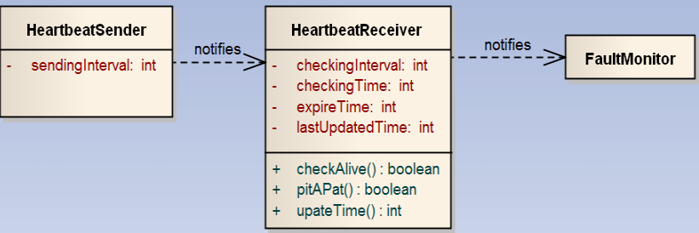
Heartbeat Tactic Class Model
HeartbeatSender sends a periodic heartbeat message via pitApat()
HeartbeatReceiver updates lastUpdatedTime with updateTime()
HeartbeatReceiver every checkingInterval compares the lastUpdatedTime against expireTime using checkAlive()
If the test fails an exception is thrown

Slide 10
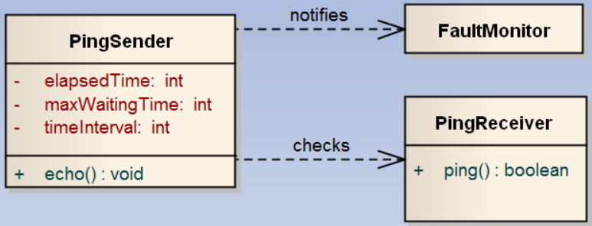
Ping/Echo Tactic Class Model
PingSender sends a ping message at specified timeIntervals
PingSender waits for an echo from a ping receiver until maxWaitingTime
If an echo is not received an exception occurs, and it is detected by the fault monitor.

Slide 11
Tactics and QA Interactions (Tradeoffs)
Each tactic has pluses (its reason for being) and minuses – side effects.
Use other tactics to help alleviate the minuses.
But nothing is free…

Slide 12
Tactics and Interactions - 1
For an availability QA, a common tactic for detecting faults is Ping/Echo.
Common side-effects of Ping/Echo are:
Security: how to prevent a ping flood attack?
Performance: how to ensure that the performance overhead of ping/echo is small?
Modifiability: how to add ping/echo to the existing architecture?
Notes:
Tactic is fine grain adjustment of quality attributes within a pattern

Slide 13
Tactics and Interactions - 2
System
Ping/Echo
*
Add to
system
Ping
flood
Performance
overhead
Notes:
Tactic is fine grain adjustment of quality attributes within a pattern

Slide 14
Tactics and Interactions - 3
A tactic to address the performance side-effect is “Increase Available Resources”.
Common side effects of Increase Available Resources are:
Cost: increased resources cost more
Performance: how to utilize the increase resources efficiently?
Notes:
Tactic is fine grain adjustment of quality attributes within a pattern

Slide 15
Tactics and Interactions - 4
System
Ping/Echo
Add to
system
Ping
flood
Performance
overhead
Increase Available
Resources
Cost
Resource
Utilization
*
Notes:
Tactic is fine grain adjustment of quality attributes within a pattern

Slide 16
Tactics and Interactions - 5
A tactic to address the efficient use of resources side-effect is “Scheduling Policy”.
Common side effects of Scheduling Policy are:
Modifiability: how to add the scheduling policy to the existing architecture
Modifiability: how to change the scheduling policy in the future?
Notes:
Tactic is fine grain adjustment of quality attributes within a pattern

Slide 17
Tactics and Interactions – 6
System
Ping/Echo
Add to
system
Ping
flood
Performance
overhead
Increase Available
Resources
Cost
Resource
Utilization
Scheduling
Policy
*
Add to
system
Modify
policy
Notes:
Tactic is fine grain adjustment of quality attributes within a pattern

Slide 18
Tactics and Interactions - 7
A tactic to address the addition of the scheduler to the system is “Use an Intermediary”.
Common side effects of Use an Intermediary are:
Modifiability: how to ensure that all communication passes through the intermediary?
Notes:
Tactic is fine grain adjustment of quality attributes within a pattern

Slide 19
Tactics and Interactions - 8
System
Ping/Echo
Add to
system
Ping
flood
Performance
overhead
Increase Available
Resources
Cost
Resource
Utilization
Scheduling
Policy
Add to
system
Modify
policy
Use an
Intermediary
Ensure
usage
Notes:
Tactic is fine grain adjustment of quality attributes within a pattern

Slide 20
Tactics and Interactions – 9
A tactic to address the concern that all communication passes through the intermediary is “Restrict Communication Paths”.
Common side effects of Restrict Communication Paths are:
Performance: how to ensure that the performance overhead of the intermediary are not excessive?
Note: this design problem has now become recursive!
Notes:
Tactic is fine grain adjustment of quality attributes within a pattern

Slide 21
How Does This Process End?
Each use of tactic introduces new concerns.
Each new concern causes new tactics to be added.
Are we in an infinite progression?
No. Eventually the side-effects of each tactic become small enough to ignore.

Slide 22
Summary
An architectural pattern
  is a package of design decisions that is found repeatedly in practice,
  has known properties that permit reuse, and
  describes a class of architectures.
Tactics are simpler than patterns
Patterns are underspecified with respect to real systems so they have to be augmented with tactics.
  Augmentation ends when requirements for a specific system are satisfied.

Slide 23
Addendum

Slide 24
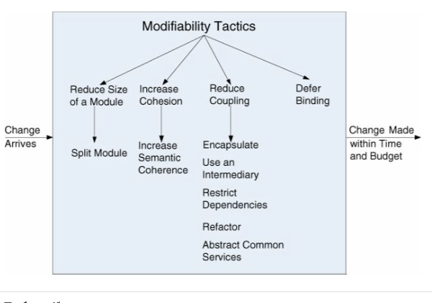
Modifiability Tactics
Paper on Modifiability Tactics:
https://resources.sei.cmu.edu/library/asset-view.cfm?assetid=8299

Slide 25
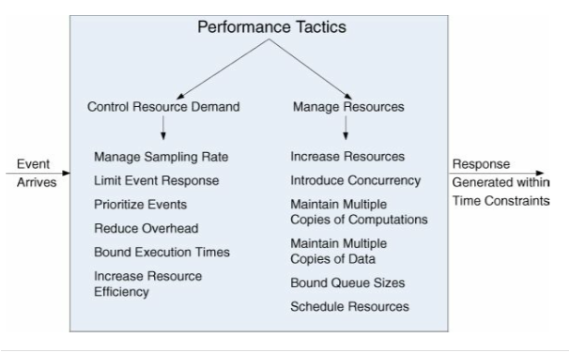
Performance Tactics

Slide 26
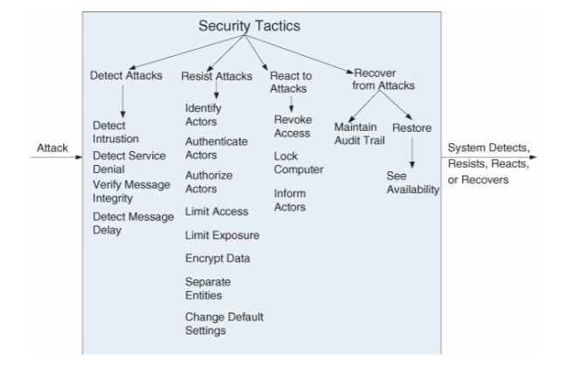
Security Tactics

Slide 27
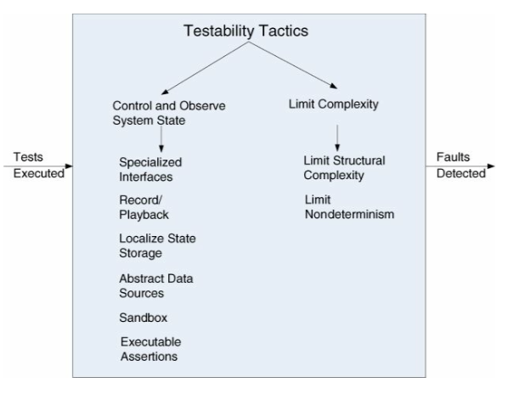
Testability Tactics

Slide 28
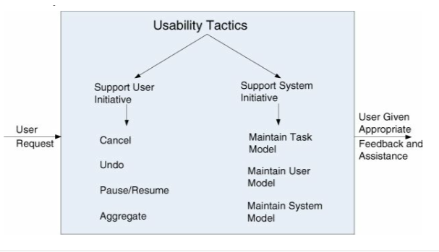
Usability Tactics

